Slide 1
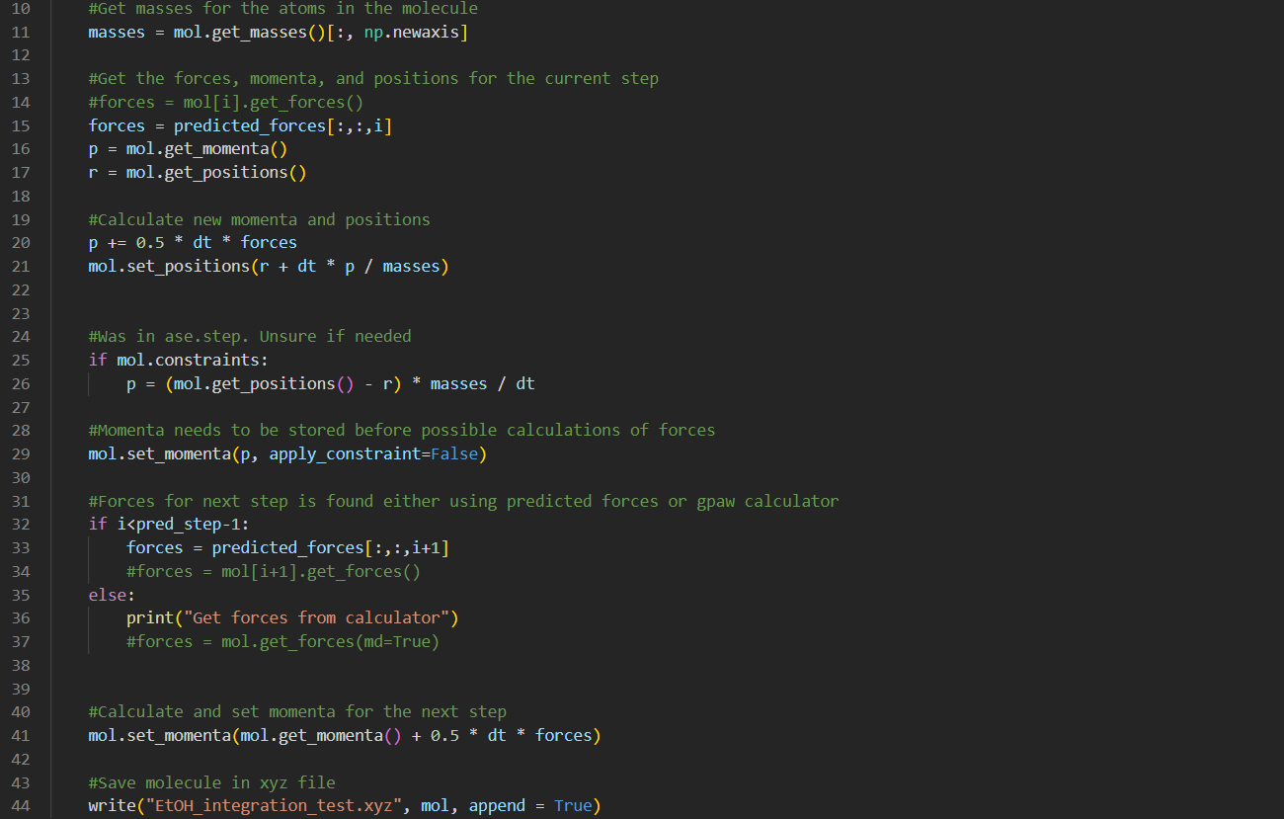

Slide 2
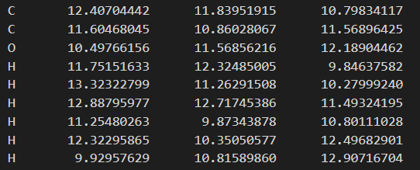
Calculating momenta and positions with correct forces
Simulation
Calculation

Slide 3
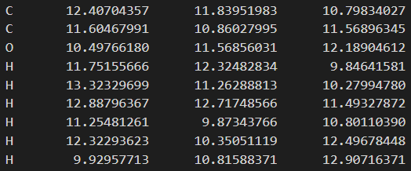
Calculating momenta and positions with predicted forces (1st prediction)
Simulation
Calculation

Slide 4
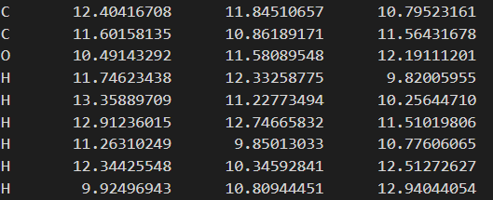
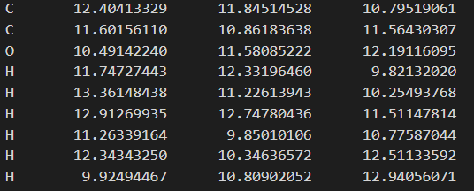
Calculating momenta and positions with predicted forces (3rd prediction)
Simulation
Calculation

Slide 5
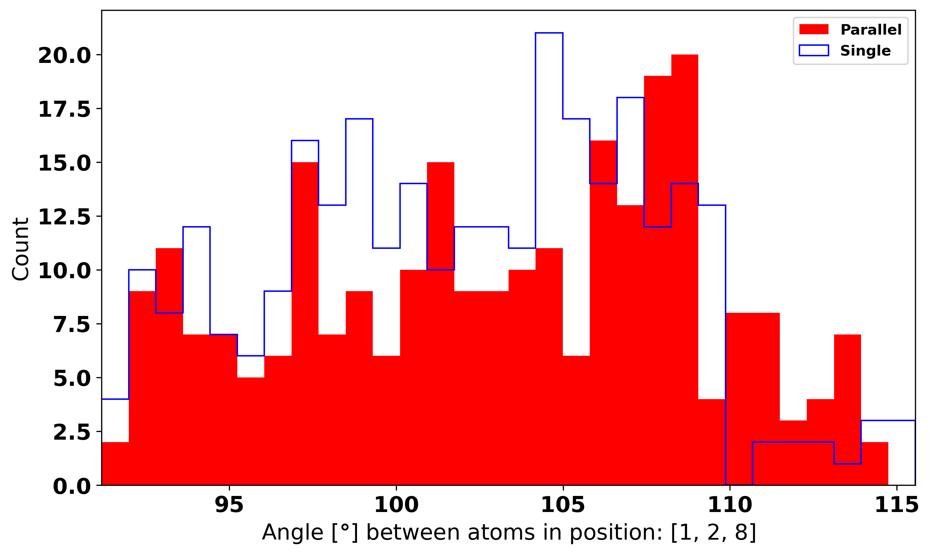
Histogram of angle

Slide 6
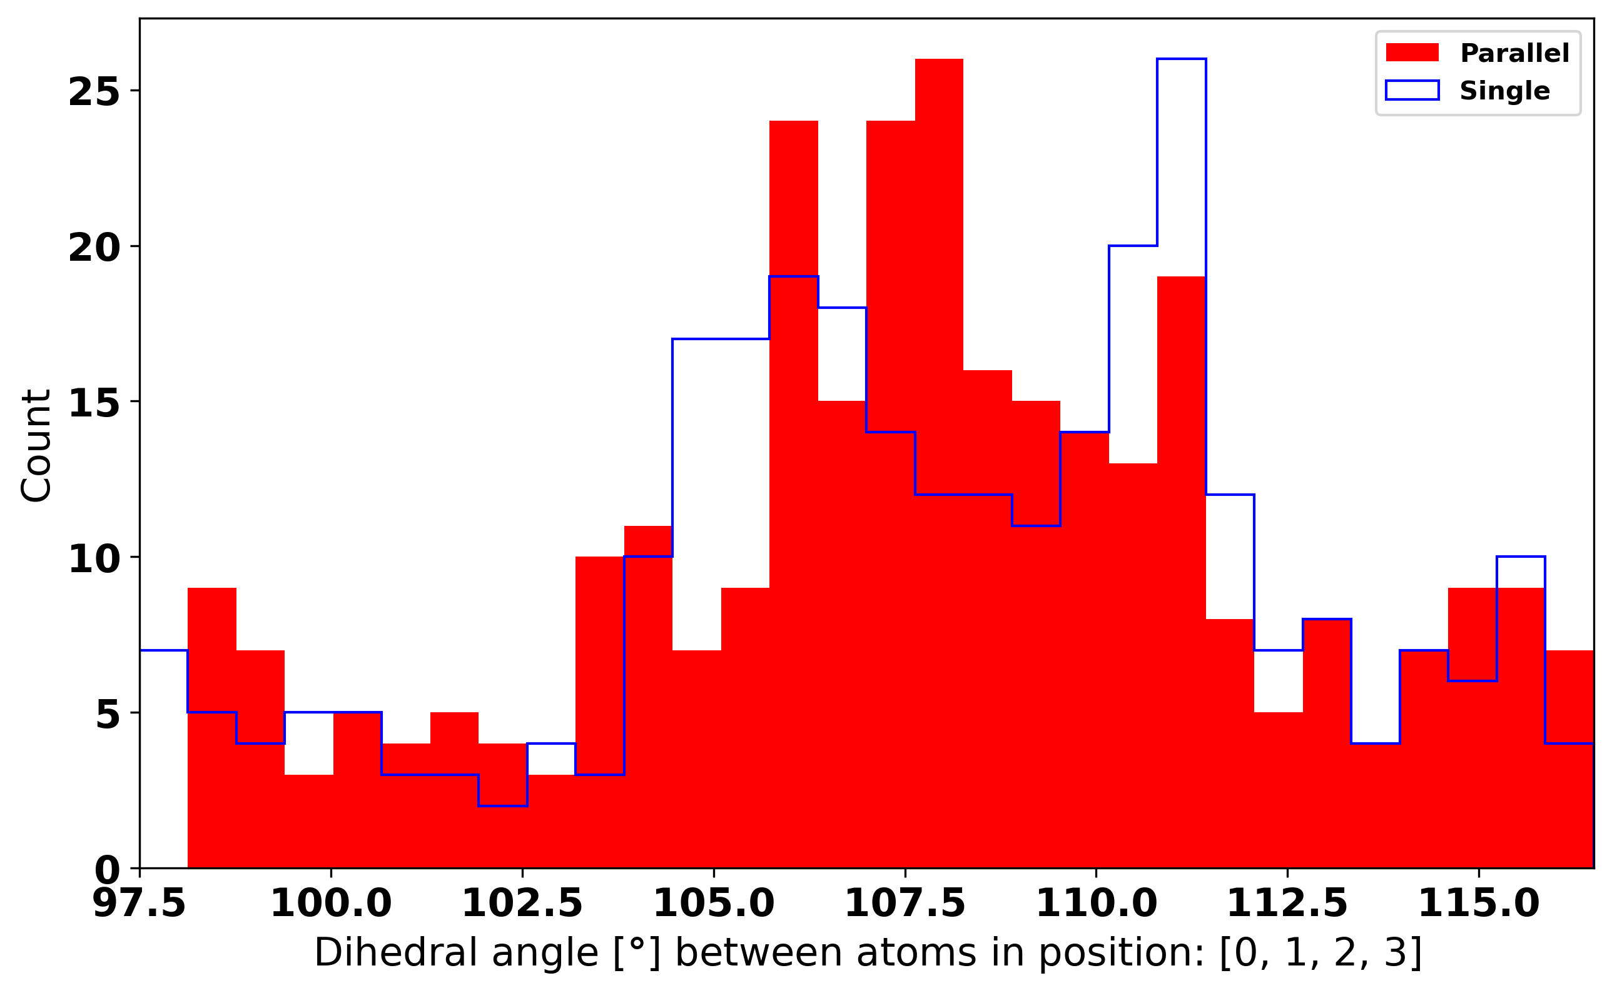
Histogram of dihedral angle

Slide 7
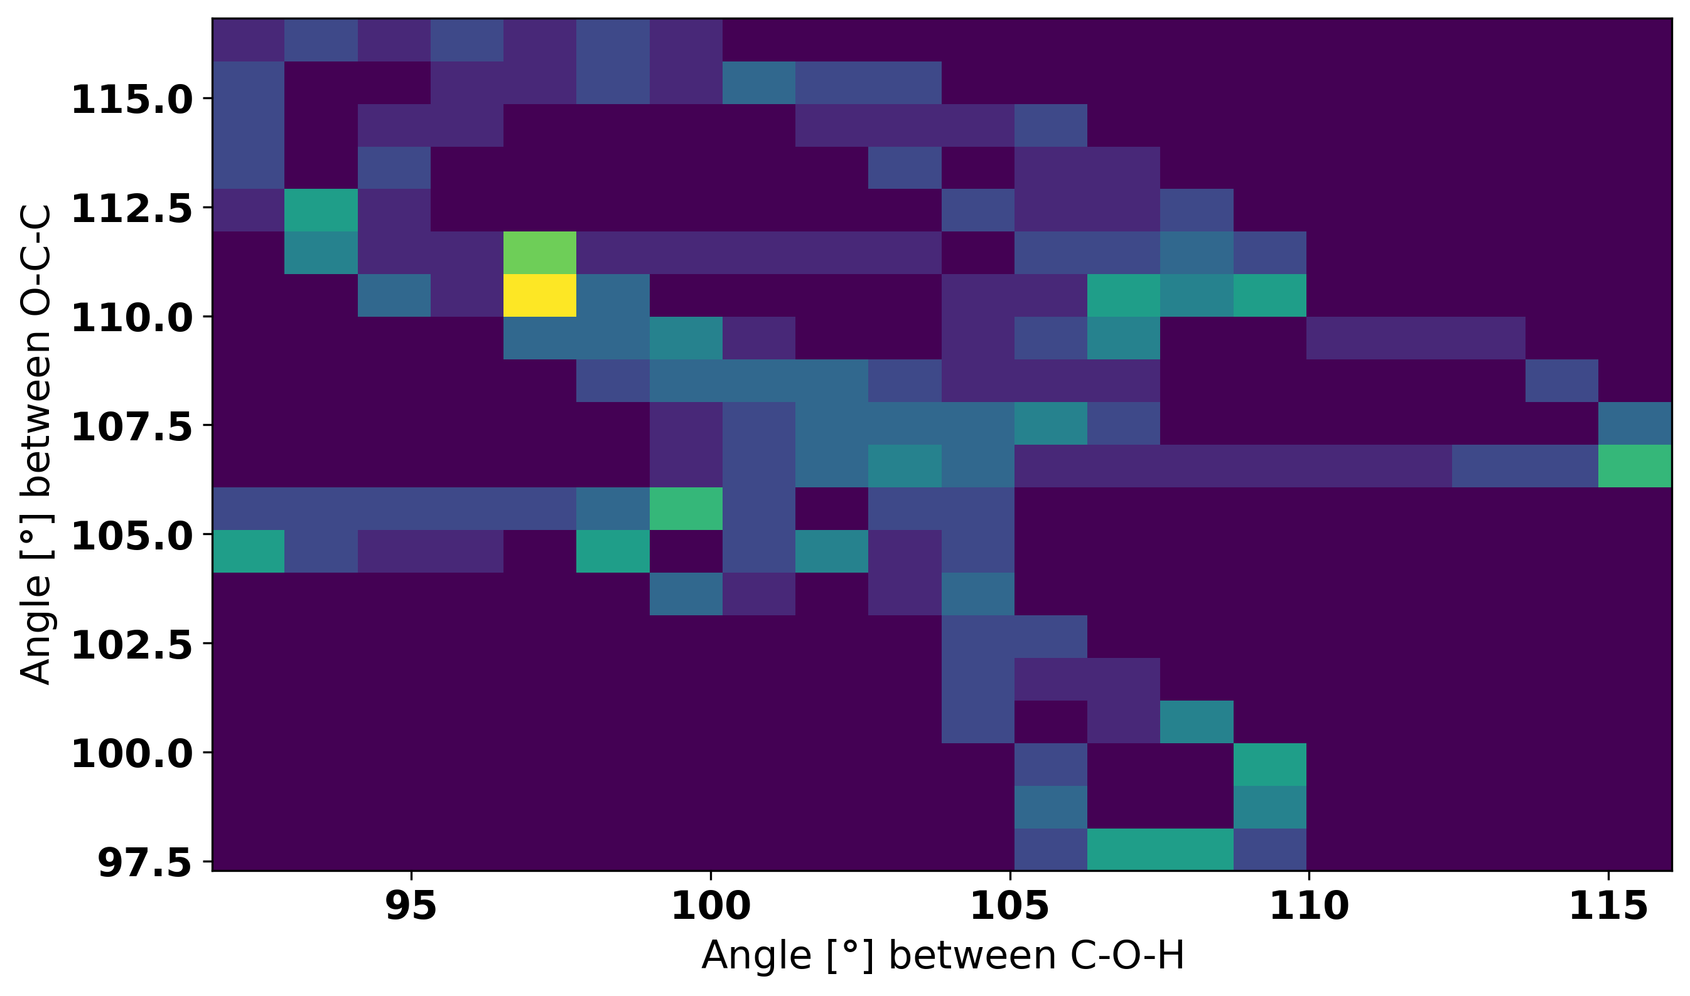
2D Histogram of angle

Slide 8
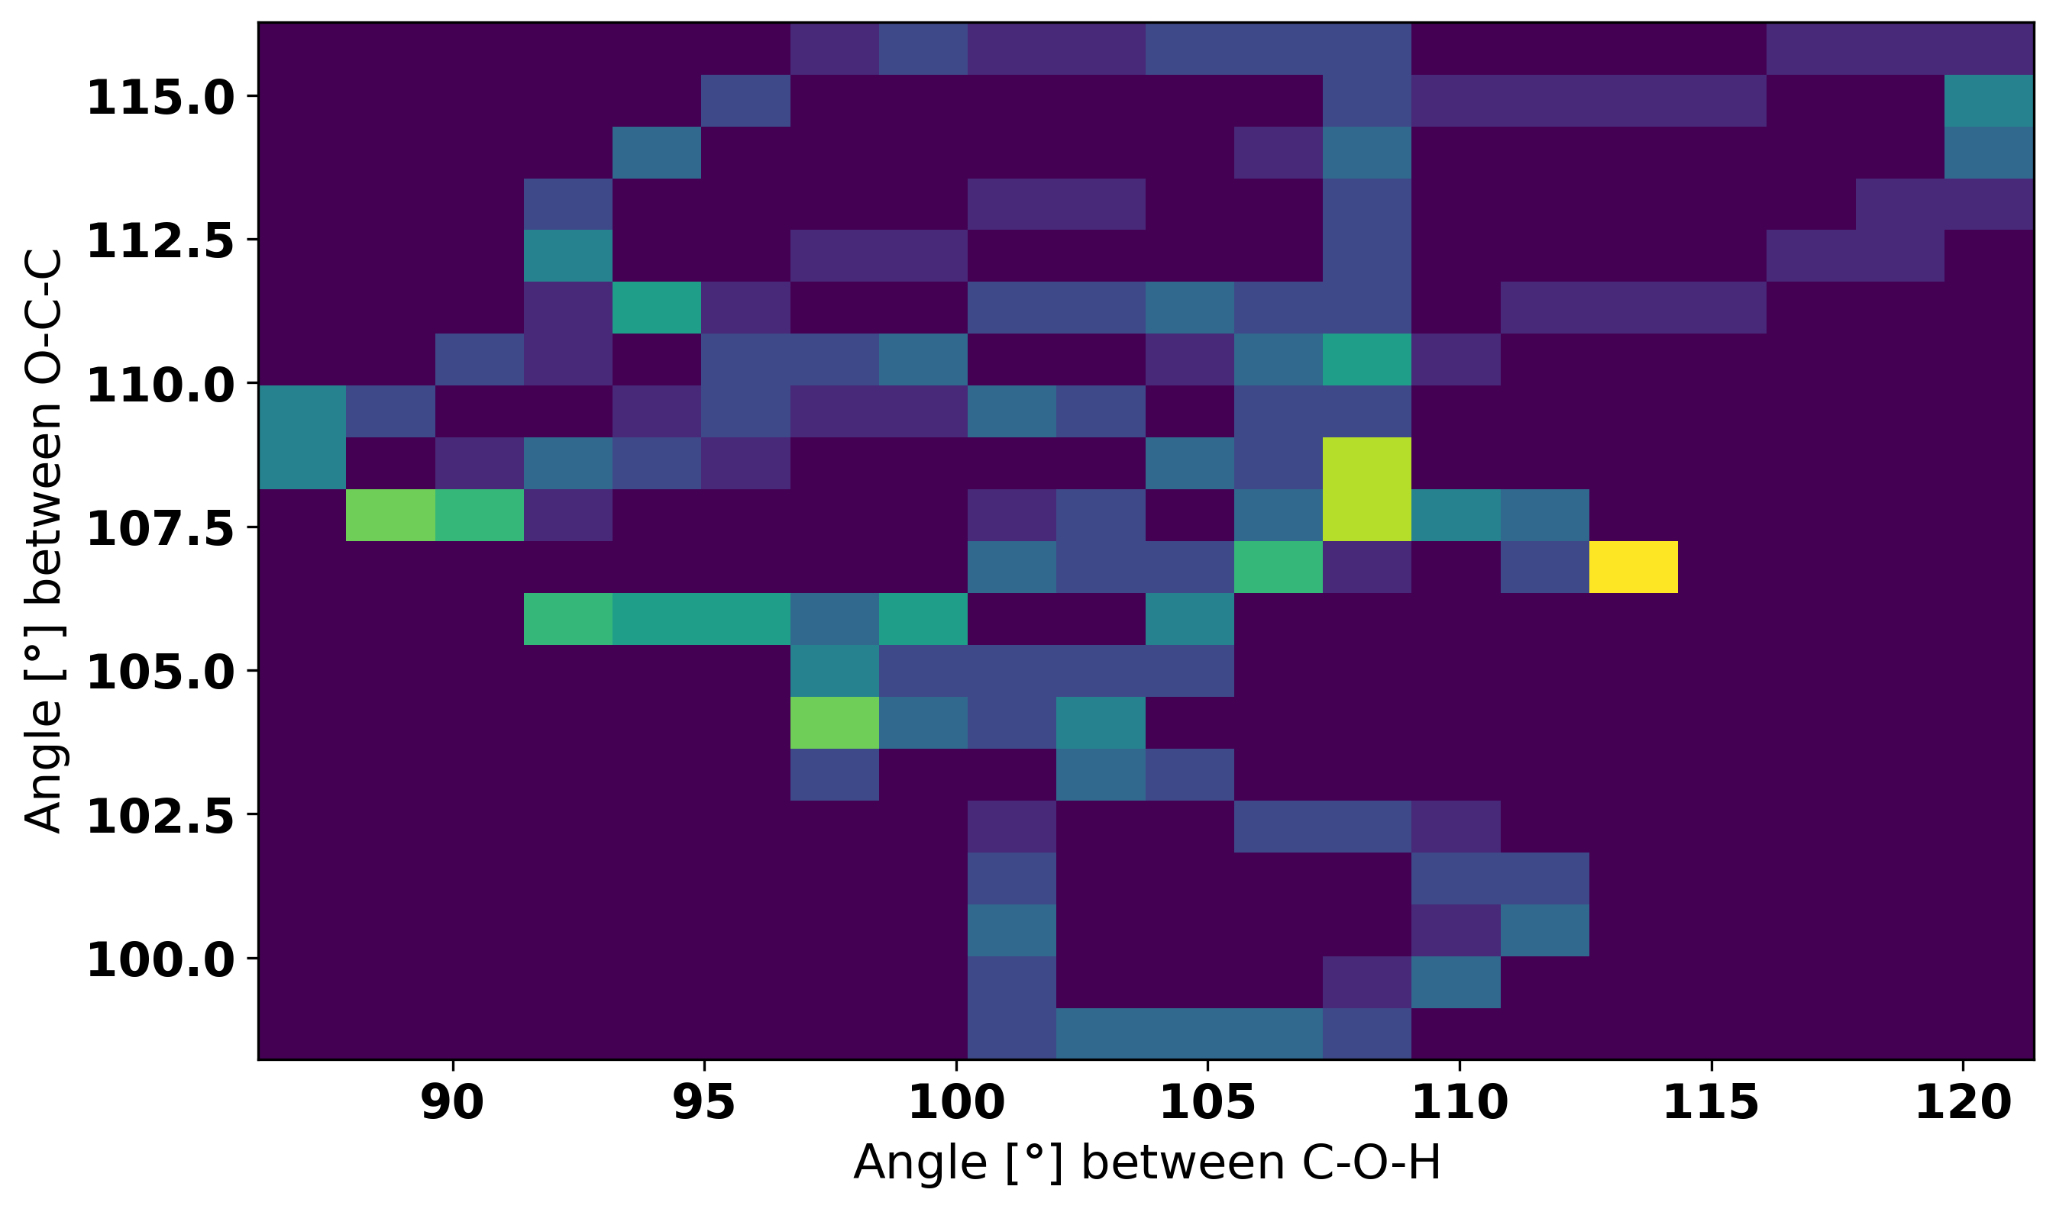
2D Histogram of angle

